Slide 1

League of Legend
eSports Statistics
Author: Kermit Mitchell III
Date: 12/05/2017

Slide 2
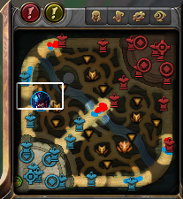
What is League of Legends anyway?
An online computer game (MOBA)
Two teams of five compete to destroy the enemy base (Nexus)
The towers and mini-bases (inhibitors) have to be destroyed first
Each team has minions that help them destroy structures.
The jungle has neutral monsters that grant bonuses upon their death

Slide 3
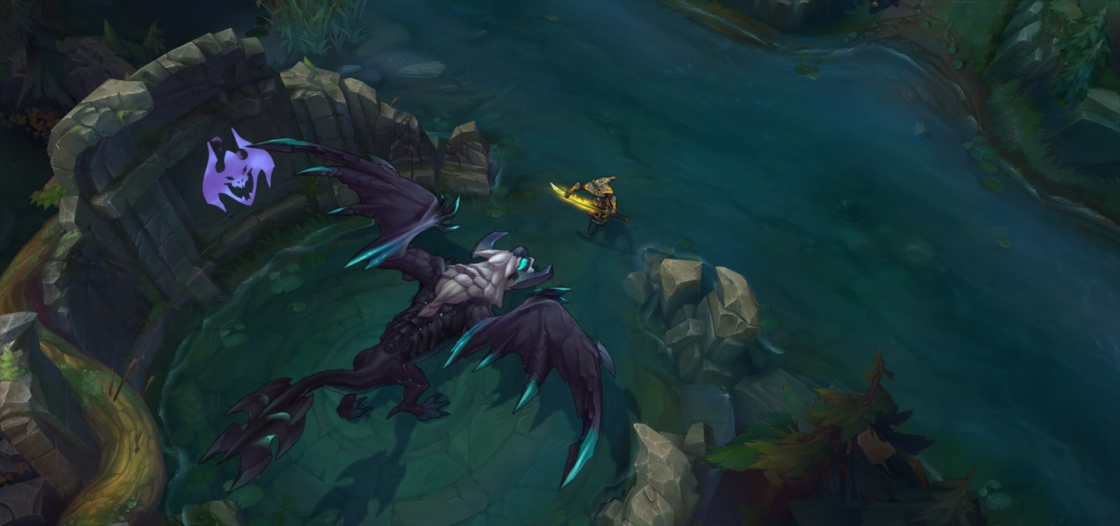
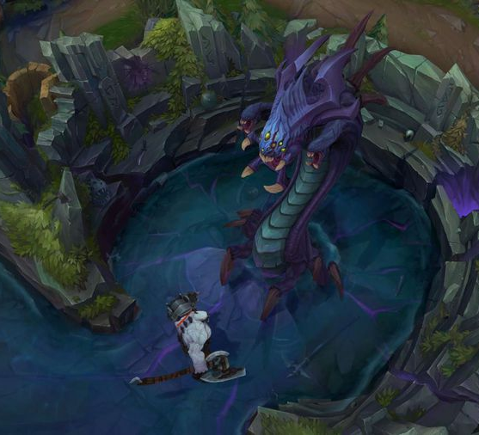
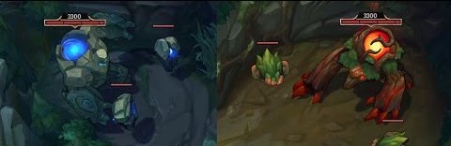
What bonuses are we talkin’?
Red Buff: Increased health regeneration and bonus damage
Blue Buff: Increased mana regeneration and cooldown reduction
Dragon: Increased damage/structure/movement speed/regenerations (element based)
Baron: Increased everything, plus minion damage increase

Slide 4
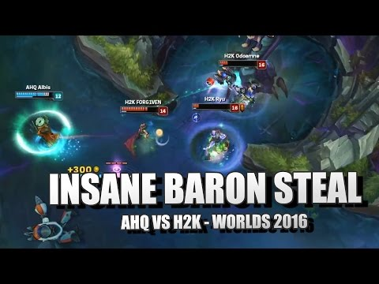
So what’s your main question?
Slaying the neutral monsters is optional for winning
Is trying to slay them worth the potential risks?
Does taking neutral monsters for your team increase odds of victory?
Let’s find out!

Slide 5
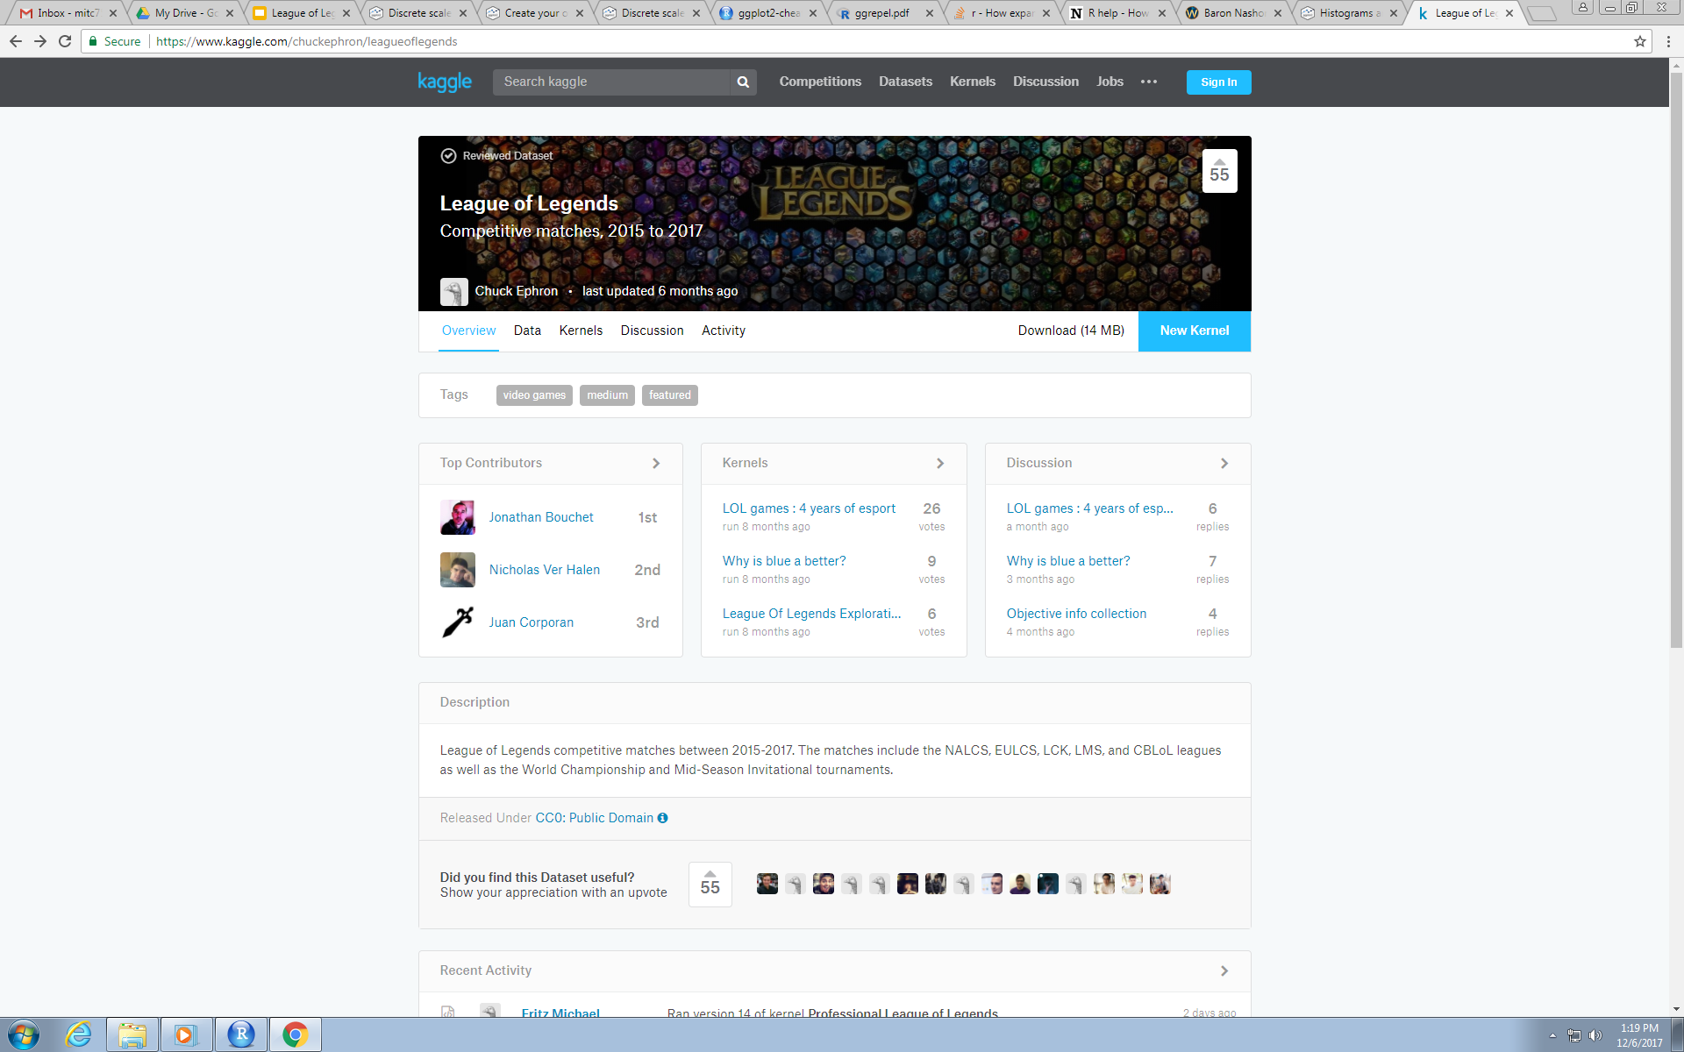
My Dataset
I used data from the League of Legends World Championships from 2015-2017 (3802 games)
All professional players making the “best” decisions at “peak” performance.
Source: https://www.kaggle.com/chuckephron/leagueoflegends

Slide 6
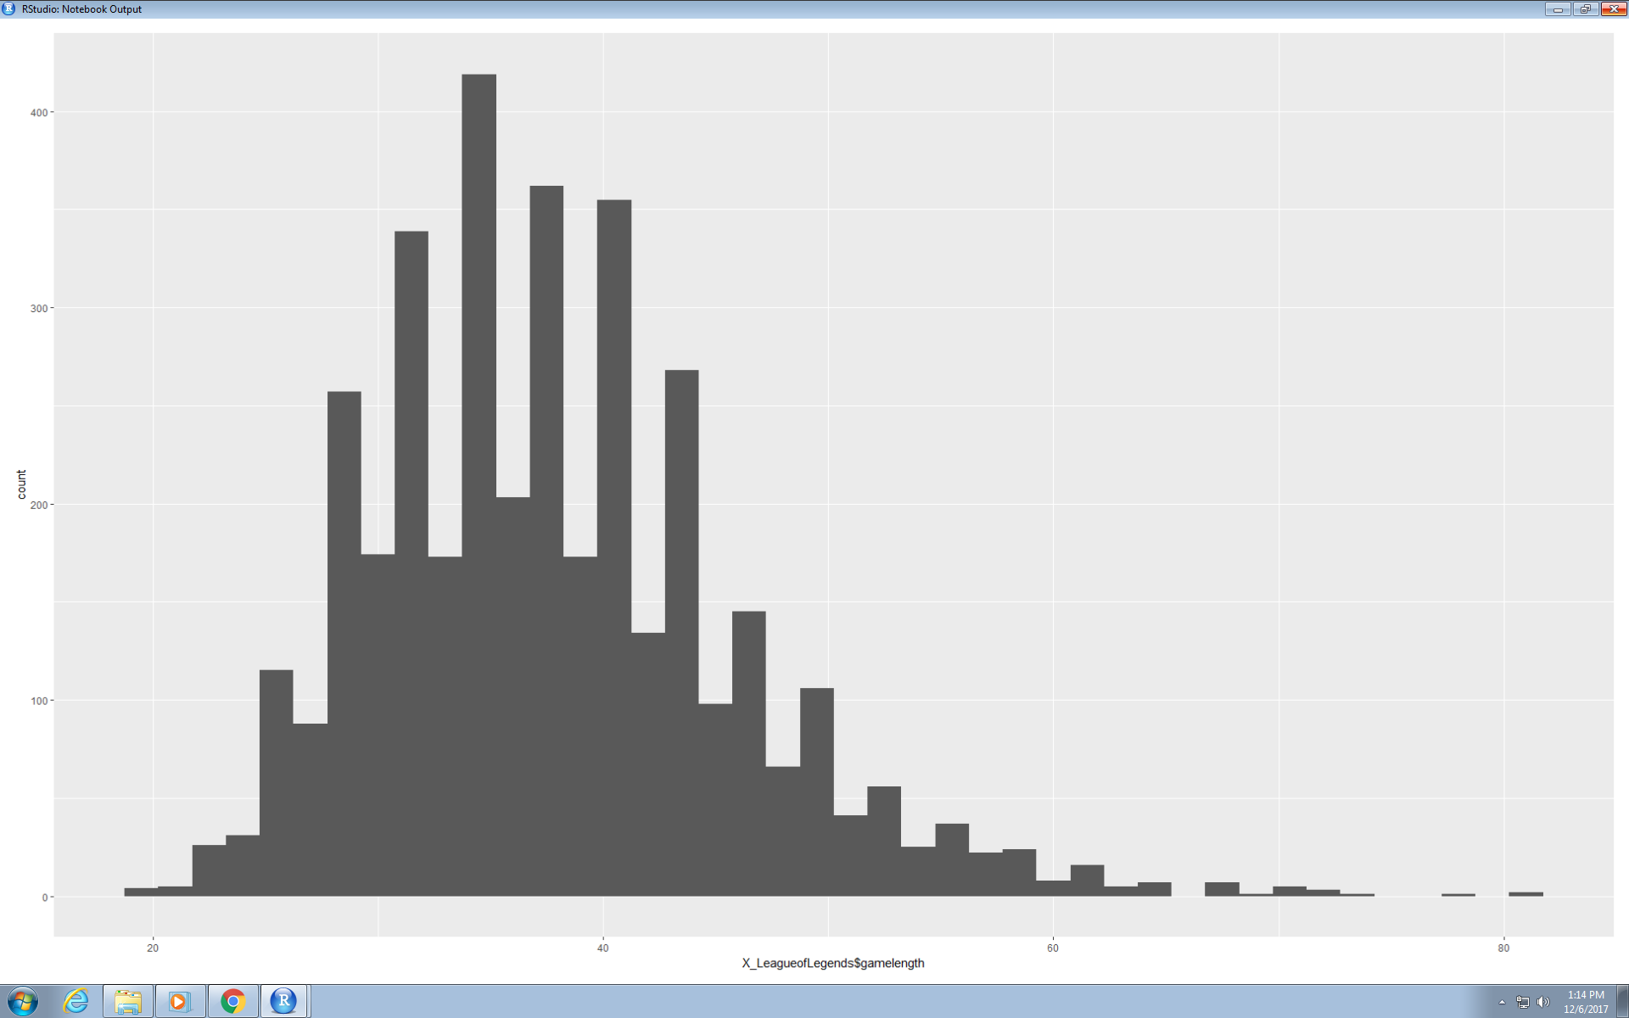
The Graphs (Game Durations)

Slide 7
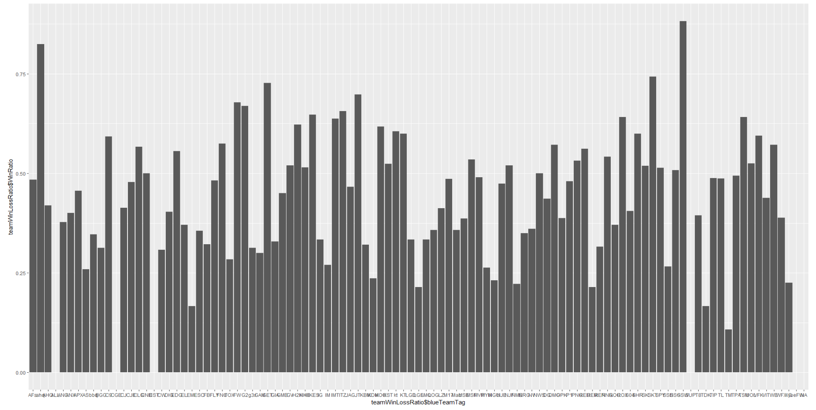
The Graphs (Team W/L Ratios)

Slide 8
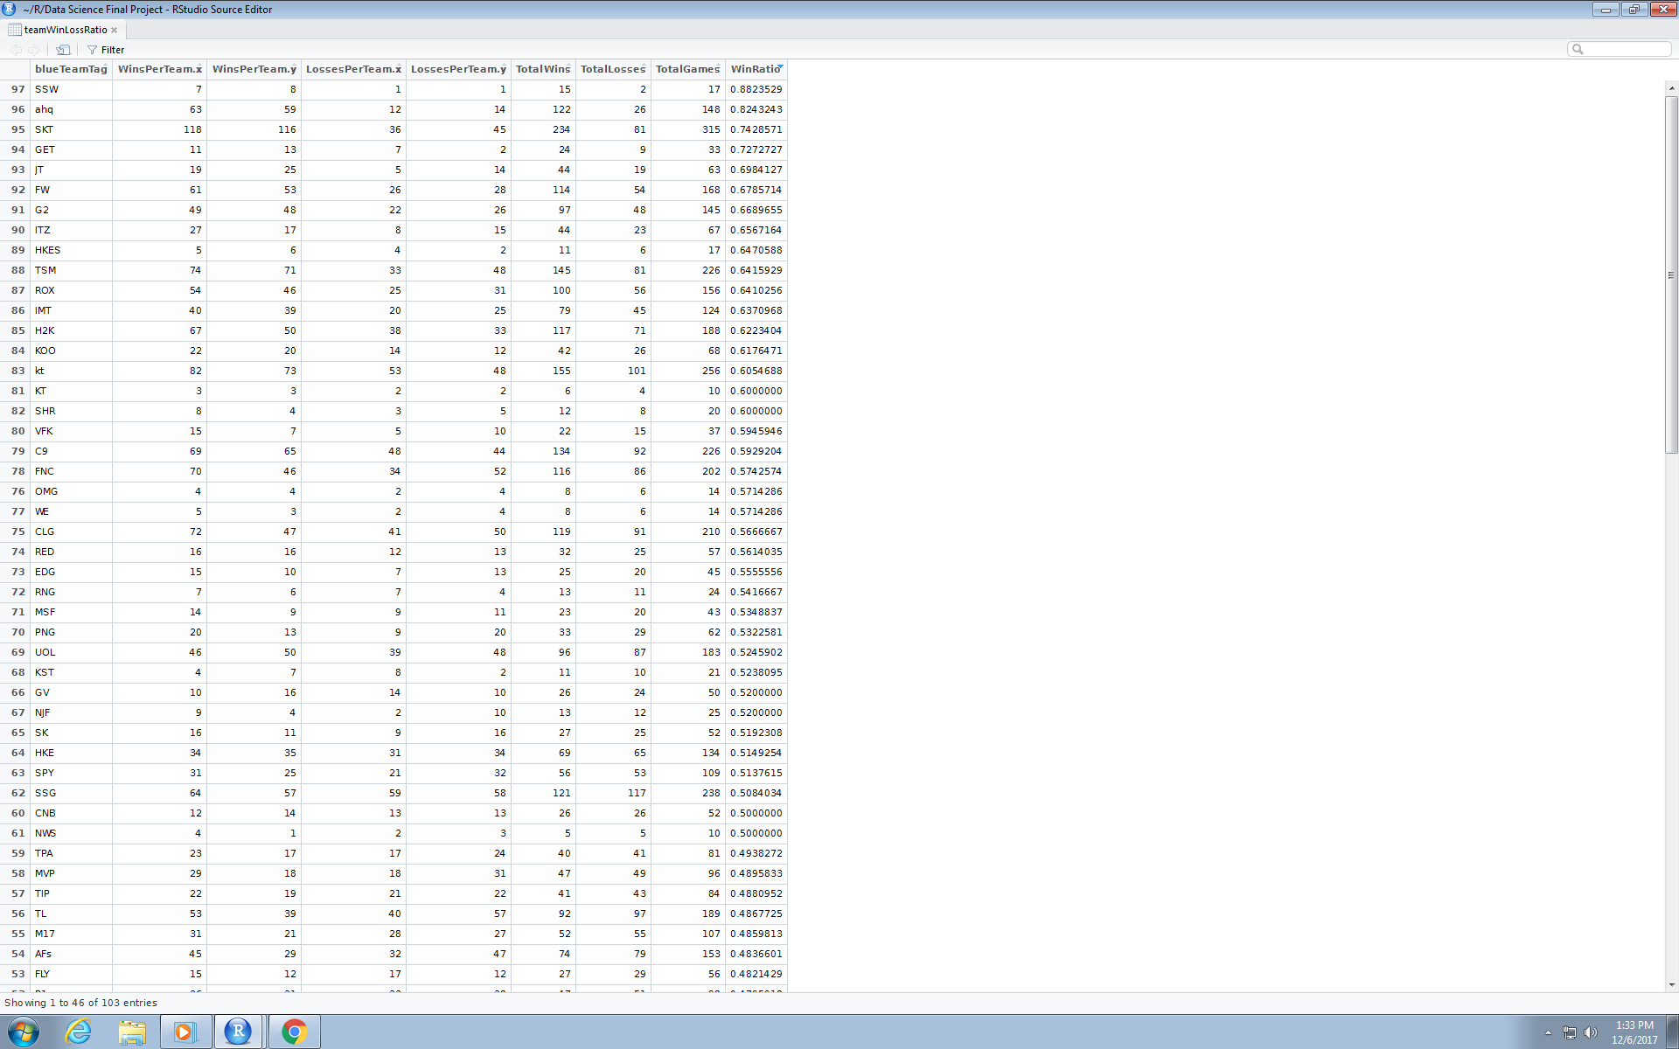
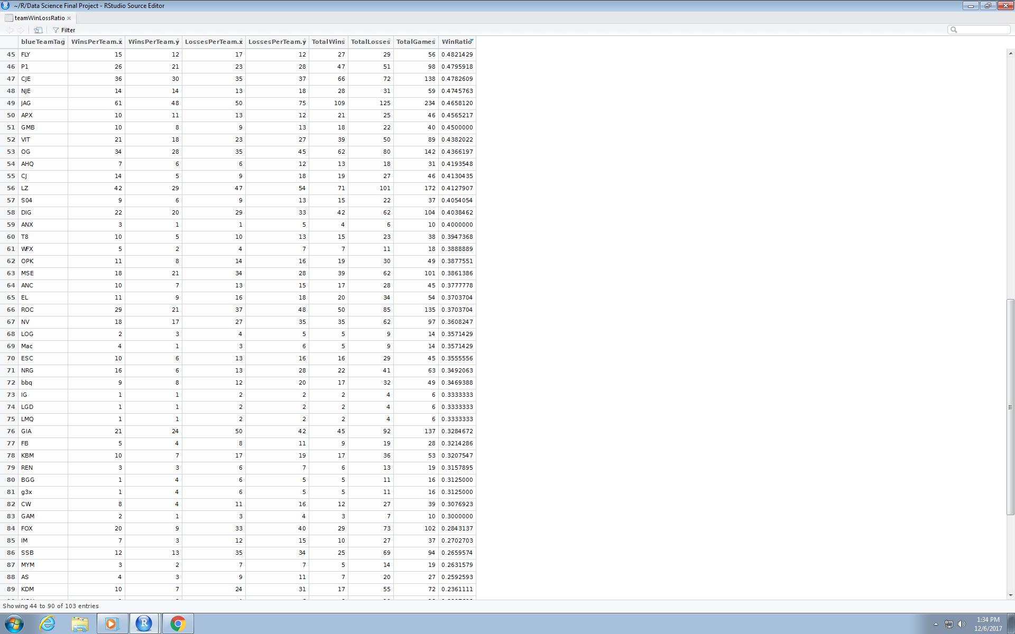

Slide 9
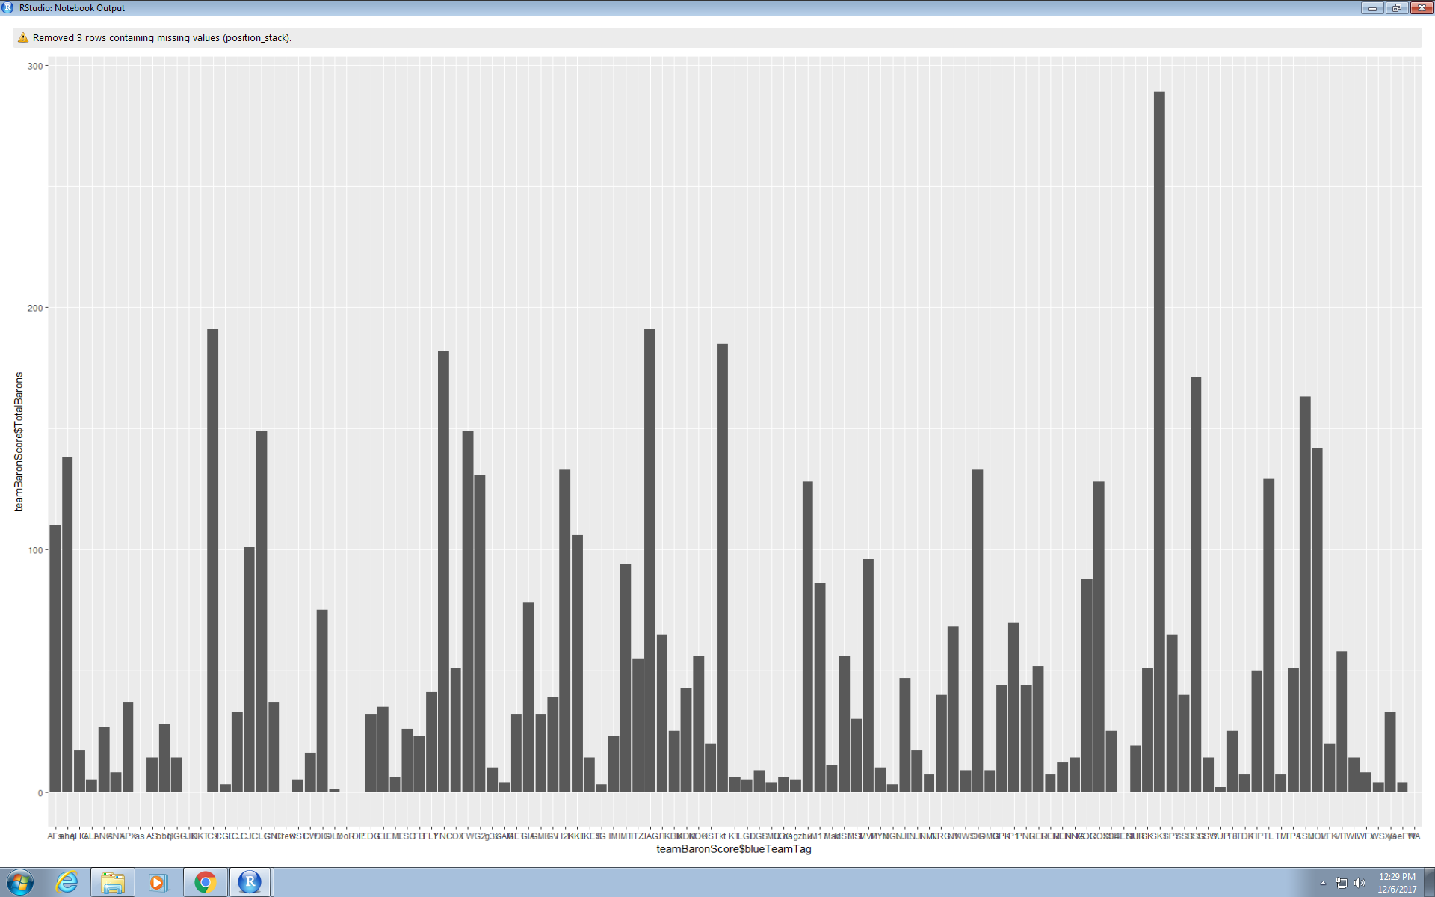
The Graphs (Team BaronScores)

Slide 10
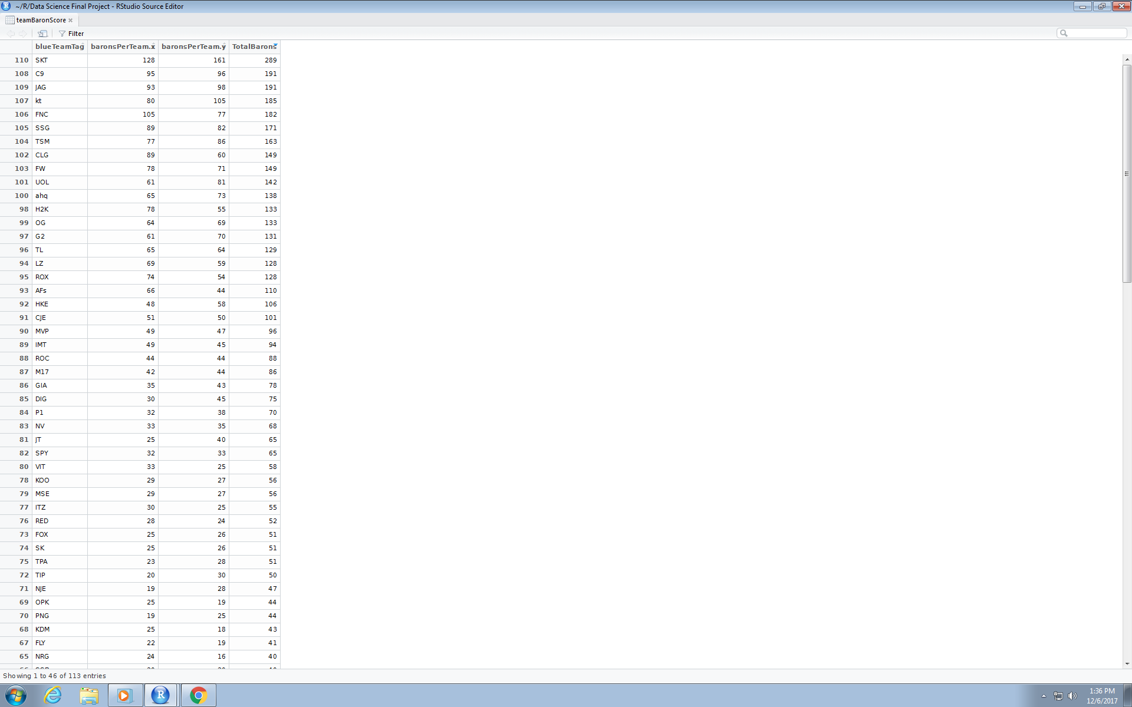
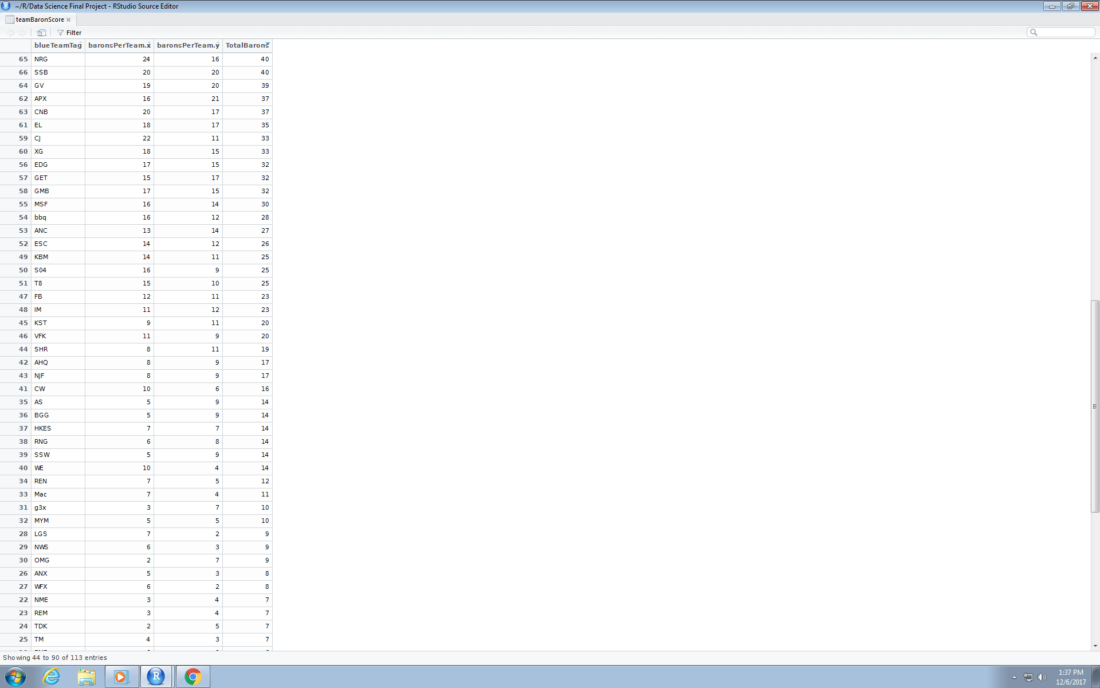
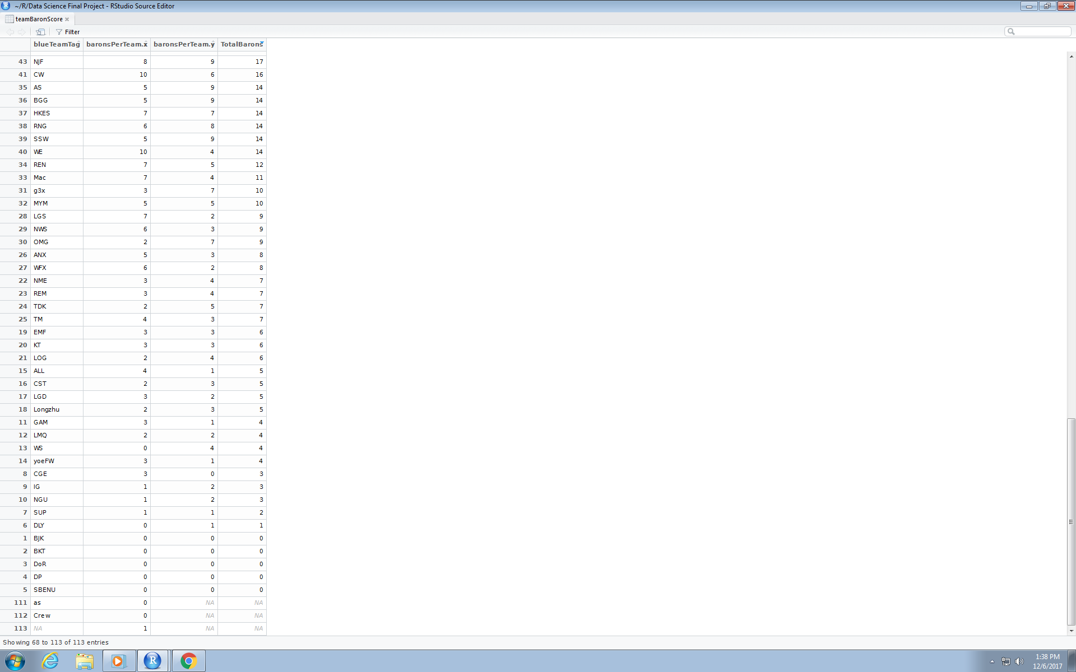

Slide 11
My Conclusion
Baron slightly boosts chances of victory, but it’s not worth the risks involved
It is important to note that several things affect victory:
Obviously, correlation doesn't imply causation, but SKT both has highest win rate AND highest BaronScore, however, there are most likely lurking and confounding variables: gold, kills, towers, mood, attitude, communication; so it's hard to tell if Baron truly is the cause for victories
It would be nice if there was a Pro_Teams table that included the team statistics all together; I had to piece together the data myself

Slide 12
Sources
Data Set: https://www.kaggle.com/chuckephron/leagueoflegends
LoL Minimap: https://upload.wikimedia.org/wikipedia/ru/4/49/Summoners_Rift_minimap.png
Red/Blue Buffs: https://i.ytimg.com/vi/VKFMW4VSFd4/hqdefault.jpg

